Slide 2
The Great Resignation is a phenomenon that describes record numbers of people leaving their jobs after the COVID-19 pandemic ends.
Resignation rates are highest in the technology and healthcare industries
https://www.weforum.org/agenda/2021/11/what-is-the-great-resignation-and-what-can-we-learn-from-it/ 29 apr 2022

Slide 3
Employees between 30 and 45 years old have had the greatest increase in resignation rates, with an average increase of more than 20% between 2020 and 2021.
https://hbr.org/2021/09/who-is-driving-the-great-resignation, 29 apr 2022

Slide 4
The future of Jobs report 2020
The report’s key findings include:
The pace of technology adoption is expected to remain unabated and may accelerate in some areas. The adoption of cloud computing, big data and e-commerce remain high priorities for business leaders, following a trend established in previous years. However, there has also been a significant rise in interest for encryption, non-humanoid robots and artificial intelligence.
Skills gaps continue to be high as in-demand skills across jobs change in the next five years. The top skills and skill groups which employers see as rising in prominence in the lead up to 2025 include groups such as critical thinking and analysis as well as problem-solving, and skills in self-management such as active learning, resilience, stress tolerance and flexibility. On average, companies estimate that around 40% of workers will require reskilling of six months or less and 94% of business leaders report that they expect employees to pick up new skills on the job, a sharp uptake from 65% in 2018.
https://www.weforum.org/reports/the-future-of-jobs-report-2020/in-full/executive-summary, 29 apr 2022

Slide 5
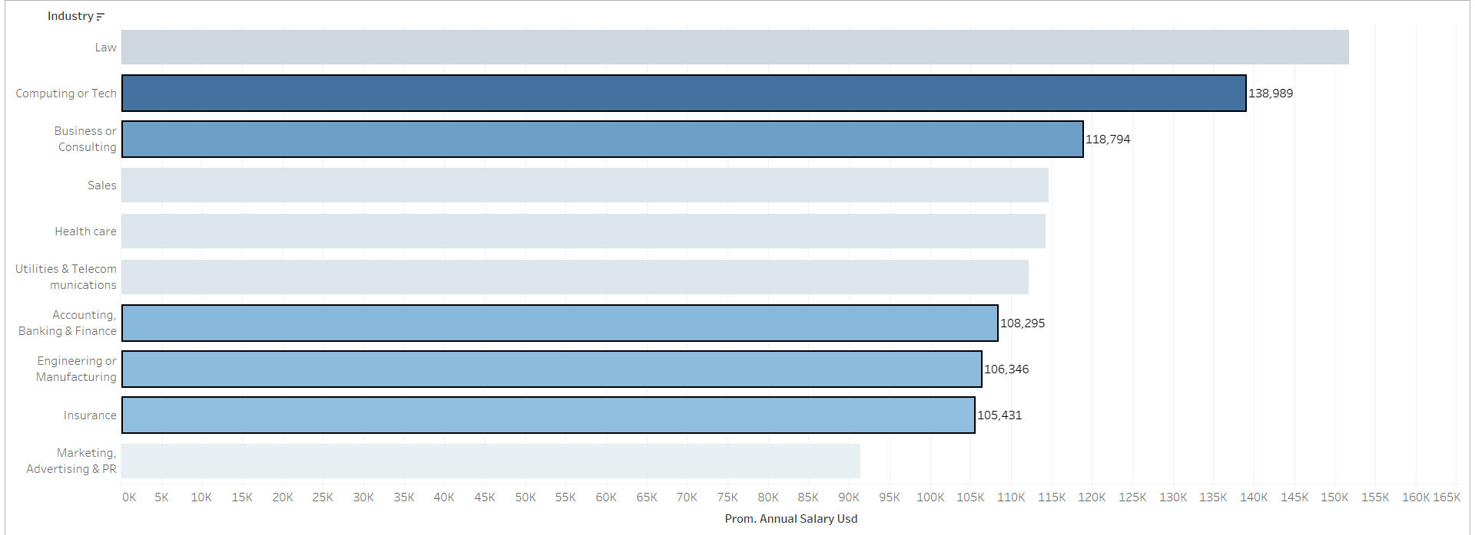

Slide 6
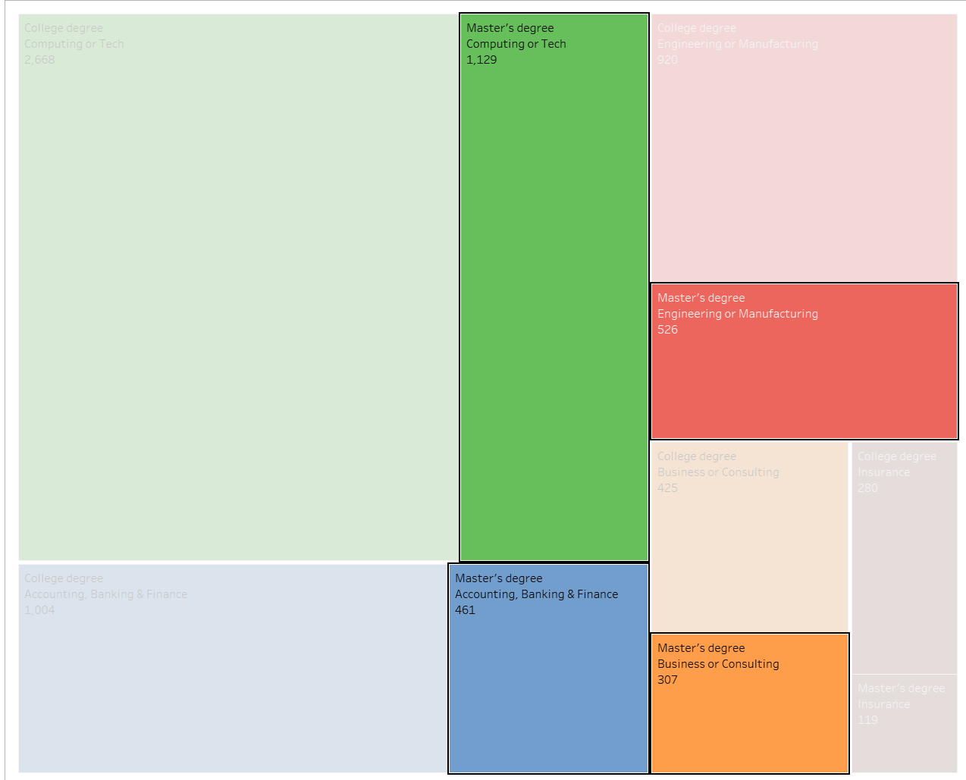

Slide 7
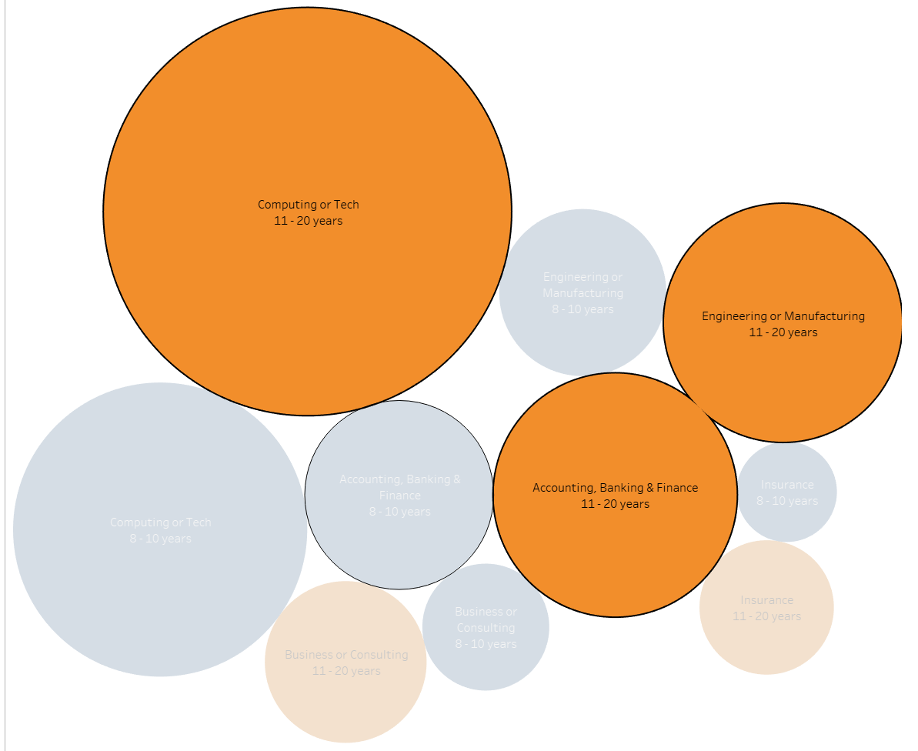

Slide 8
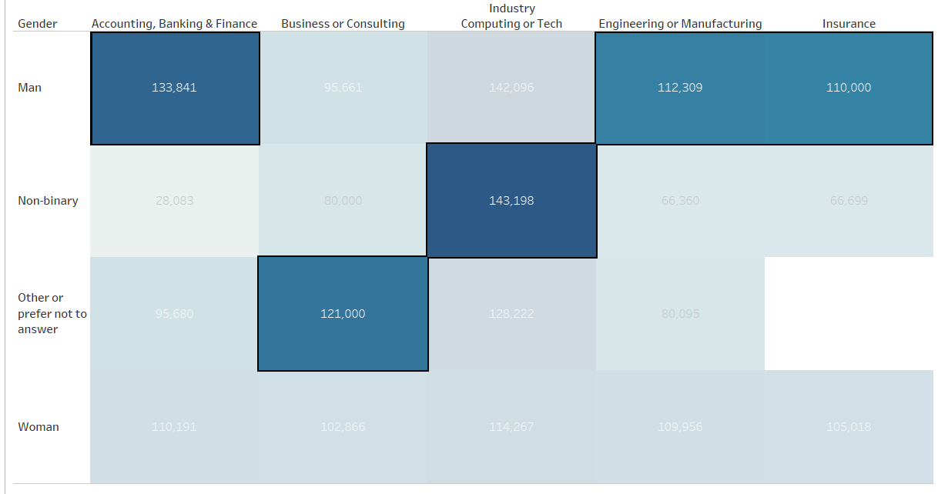

Slide 9
